Slide 1
SECURE DATA HIDING IN IMAGES USING STEGANOGRAPHY
CAPSTONE PROJECT
Presented By : Batchala Sanjana
Student Name :Batchala Sanjana
College Name & Department : Sri Sivani College of Engineering &Computer Science Engineering

Slide 2
OUTLINE
Problem Statement
Technology used
Wow factor
End users
Result
Conclusion
Git-hub Link
Future scope

Slide 3
Problem Statement
With the increasing need for secure communication, traditional text-based encryption methods are often susceptible to interception and hacking. To address this issue, a novel approach is required that embeds secret messages within an image, ensuring an additional layer of security.
This project aims to develop a Secure Image-Based Message Encryption and Decryption System using Python and OpenCV. The system will allow users to hide a secret message within an image by modifying pixel values based on an encryption algorithm. Only users with the correct passcode can decrypt and retrieve the hidden message

Slide 4
Technology used
Python-The core programming language used for implementing the encryption and decryption logic.
OpenCV (cv2) – Used for image processing, specifically for reading.
OS Module – Enables interaction with the operating system, such as opening the
encrypted image automatically
String Manipulation – Uses ASCII encoding to map characters to pixel values for
and extracting the message

Slide 5
Wow factors
.
🔒 Image-Based Encryption (Steganography)
Instead of traditional text-based encryption, the message is hidden within an image by modifying pixel values. This makes it difficult for unauthorized users to detect or intercept.
🔑 Password-Protected Decryption
The system requires a passcode for decryption, adding an extra layer of security. Even if someone gets the encrypted image, they cannot retrieve the message without the correct password.
🎭 Invisible Data Hiding
Unlike visible watermarks, this method does not make noticeable changes to the image, ensuring secrecy.
🚀 Lightweight and Fast
Uses a simple ASCII encoding technique and OpenCV for efficient image processing, making it lightweight and quick.

Slide 6
End users
🕵️ Cybersecurity Enthusiasts & Ethical Hackers
People interested in steganography and secure communication
techniques can use this as a learning tool or to experiment with data hiding.
🔐 Privacy-Conscious Individuals
Users who want to securely share sensitive messages
(e.g., passwords, confidential data) without using traditional encryption methods.
📢 Journalists & Whistleblowers
In situations where traditional communication methods are monitored,
this technique can be used to conceal critical information inside images.
👨‍💻 Developers & Researchers
Those researching data security, encryption, and steganography can use
this as a proof of concept or improve upon it with advanced algorithms.

Slide 7
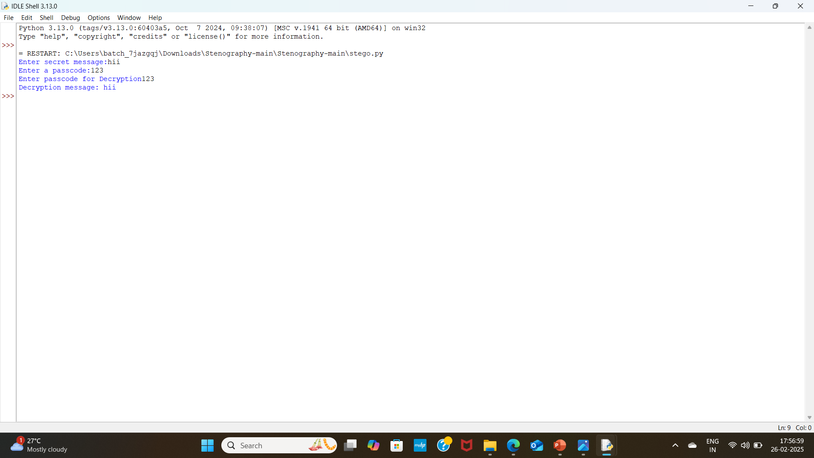
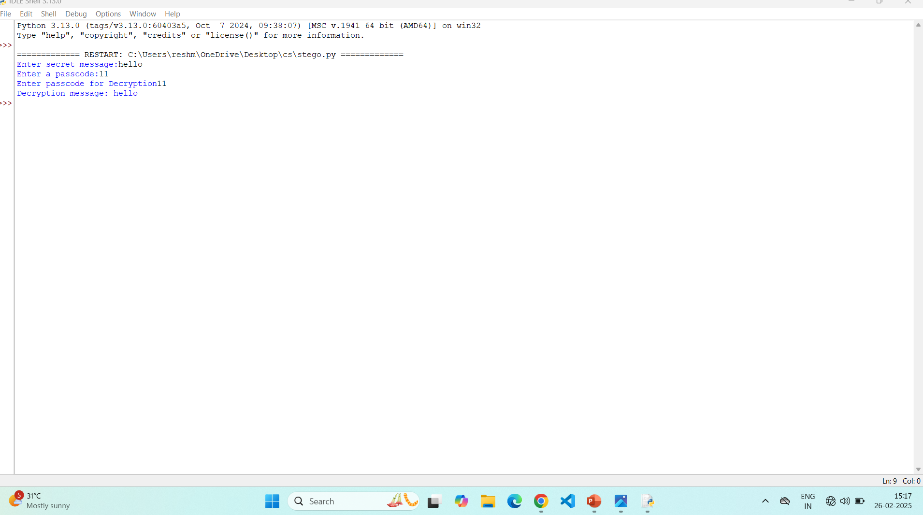
Results

Slide 8
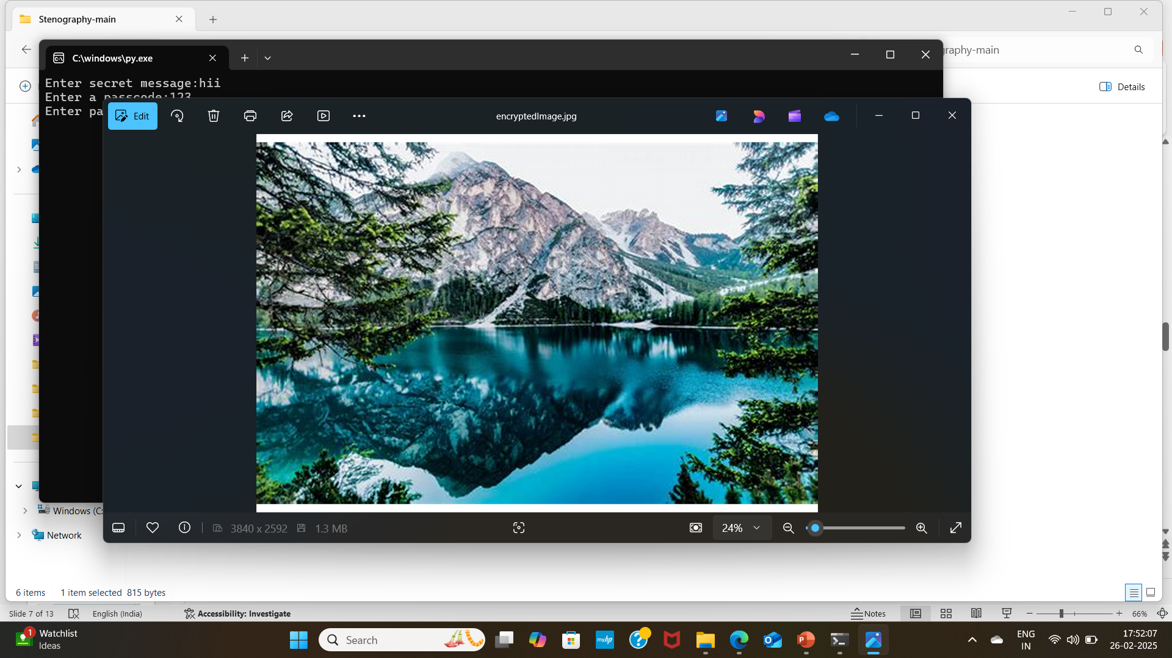
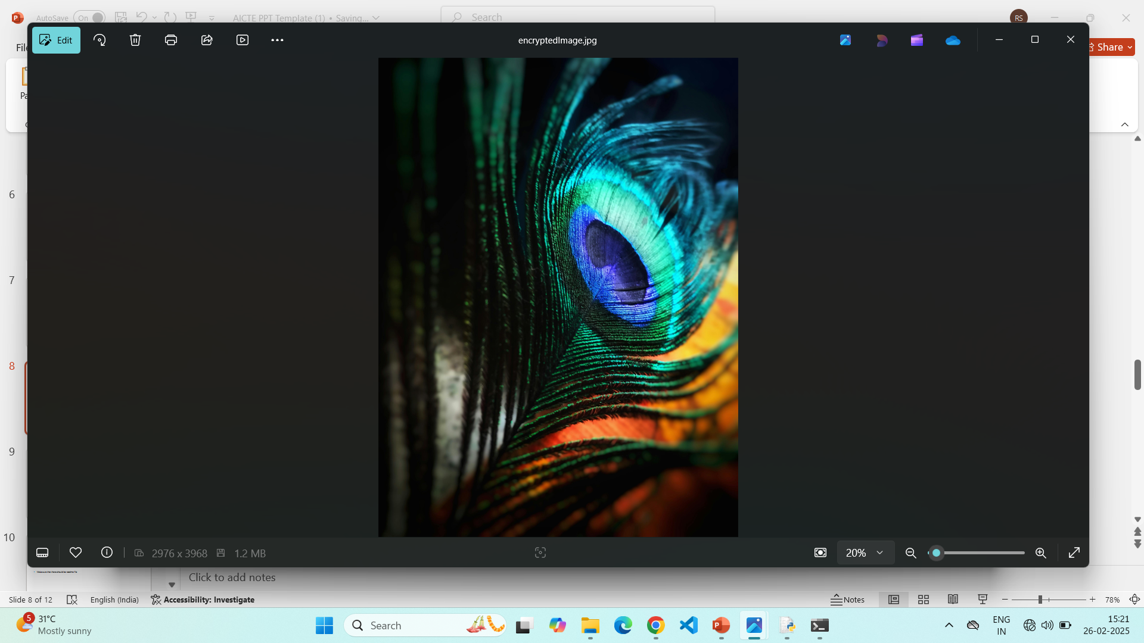
Results

Slide 9
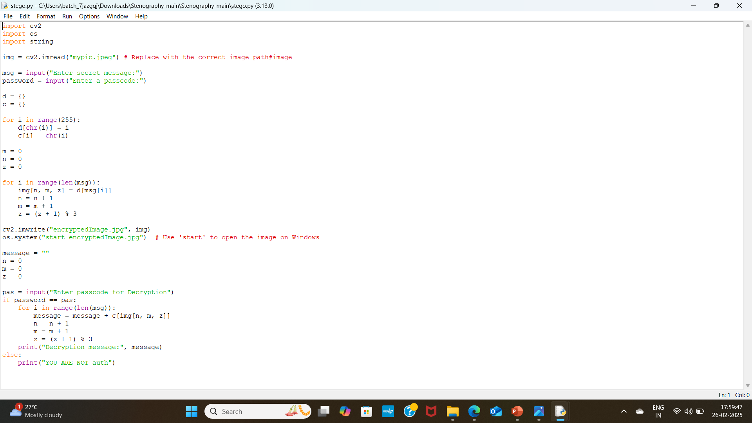
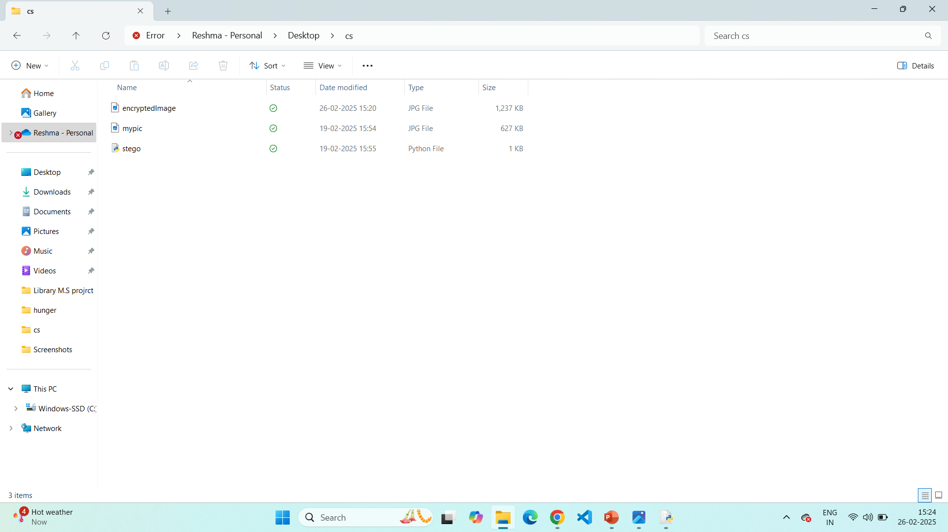
Results

Slide 10
Conclusion
This image-based encryption and decryption system successfully demonstrates a simple yet effective steganography technique by embedding a secret message into an image’s pixel values. By leveraging OpenCV for image processing and password protection for secure access, the code provides a unique and lightweight approach to hidden communication.
✅ Secure Data Hiding – The message is concealed inside an image, making it hard to detect. ✅ Password Protection – Only users with the correct passcode can retrieve the message. ✅ Lightweight & Efficient – Uses simple pixel manipulation for encoding and decoding. ✅ Potential for Expansion – Can be improved with LSB steganography, AES encryption, or GUI integration.

Slide 11
GitHub Link
https://github.com/Sanjana6704/stego.git

Slide 12
Future scope(optional)
Enhanced Security with Encryption:
Integrate cryptographic encryption (e.g., AES, RSA) before embedding the message to add another layer of protection.

Slide 13
THANK YOU

